Slide 1
GE2262 Business Statistics Topic 4 Sampling Distributions Reference Levine, D.M., Krehbiel, T.C. and Berenson, M.L., Business Statistics: A First Course, Pearson Education Ltd, Chapter 7

Slide 2
Outline
Sampling Distributions
Sampling Distribution of the Sample Mean
Standard Error of the Sample Mean
Sampling from Normal Populations
Sampling from Non-Normal Populations
The Central Limit Theorem

Slide 3
Sampling Distribution
In earlier chapters, we discussed probability distribution (e.g. binomial distribution, and normal distribution) of a random variable
Based on the assumed probability distribution, we can derive the descriptive statistics for the variables
Examples
The expected number of tagged invoices in 4 selected invoices
The expected amount filled in a 1-liter bottle

Slide 4
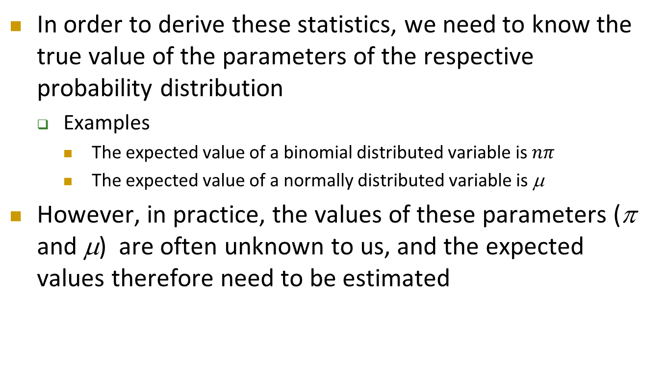
Sampling Distribution
Cont’d
In order to derive these statistics, we need to know the true value of the parameters of the respective probability distribution
Examples
The expected value of a binomial distributed variable is $nπ$
The expected value of a normally distributed variable is μ
However, in practice, the values of these parameters (π and μ) are often unknown to us, and the expected values therefore need to be estimated

Slide 5
Sampling Distribution
Cont’d
How to estimate the unknown expected value of a variable?
This is often done by :
Take a random sample of the variable from the population
Selecting a representative sample for the population is critical for this activity. In this course, we will assume the sample is a simple random sample (i.e. each member of the population has an equal chance of being selected); and the sampling is done with replacement (i.e. the same member can be selected more than once) or from an infinite population without replacement; and it is a representative one
Compute the sample mean of the observed values from the sample
The computed sample mean is considered as an estimate of the unknown expected value

Slide 6
Sampling Distribution
Cont’d
Example: A sample of 100 people was asked for the amount they spent in their last visit to supermarket. The computed sample mean of amount spent based on the sample is calculated as $203.345
We say, “the expected amount spent by the people in their last visit to supermarket is estimated as $203.345.”

Slide 7
Sampling Distribution
Cont’d
Is this estimate reliable?
If we select another 100 people from the population, we are likely to get a different sample mean for the amount spent, say $210.05
A third sample is likely to get another mean amount spent
If you are going to take only 1 sample from the population, how can a conclusion be valid if we know the sample results (sample means) vary?
What assurance do we have that the limited information from a sample will not be misleading?

Slide 8
Sampling Distribution
Cont’d
One possibility is to consider the accumulated information of “all possible samples” drawn from the population
Hold the sample size unchanged so that the sample size is not a complicating factor
The sample results (e.g. the means) from “all possible samples” can be organized into a distribution. This is called the sampling distribution
We will see this distribution assumes an important pattern for drawing inferences about the underlying population characteristics

Slide 9

Sampling Distribution of the Sample Mean
Consider a small enterprise that has 4 staff, $N=4$
Age of individuals $(X)$: 24, 26, 28, 30 measured in years
C
A
B
D

Slide 10
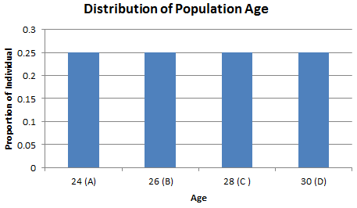
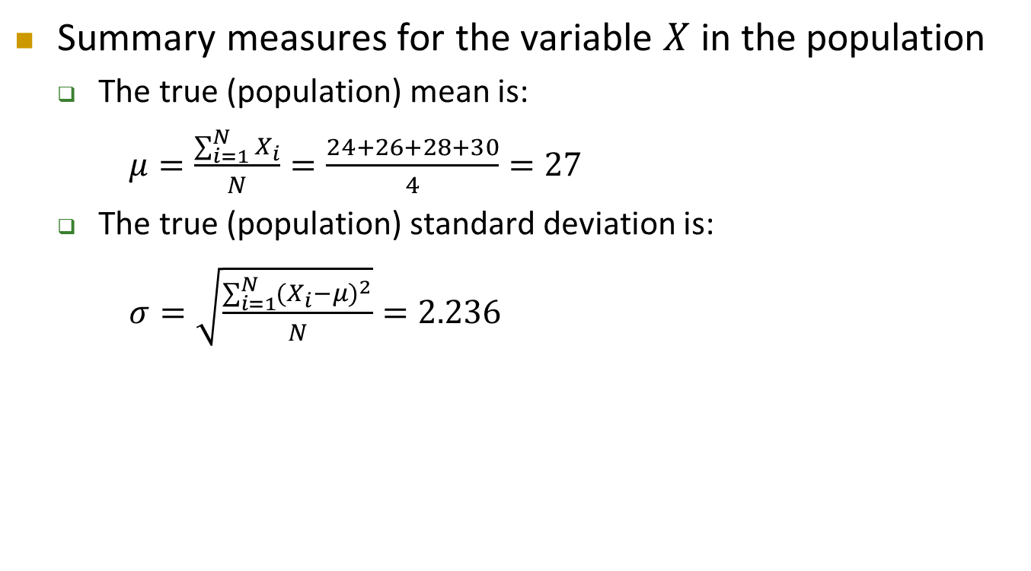
Sampling Distribution of the Sample Mean
Cont’d
Summary measures for the variable $X$ in the population
The true (population) mean is:
$μ=\frac{\sum_{i=1}^{N}{X_{i}}}{N}=\frac{24+26+28+30}{4}=27$
The true (population) standard deviation is:
$σ=\sqrt{\frac{\sum_{i=1}^{N}{{(X_{i}−μ)}^{2}}}{N}}=2.236$

Slide 11

Sampling Distribution of the Sample Mean
Cont’d
Consider all possible samples (with replacement) of size $n=2$
16 possible samples
Respondent | A | B | C | D
A | 24, 24 | 24, 26 | 24, 28 | 24, 30
B | 26, 24 | 26, 26 | 26, 28 | 26, 30
C | 28, 24 | 28, 26 | 28, 28 | 28, 30
D | 30, 24 | 30, 26 | 30, 28 | 30, 30
16 sample means
Respondent | A | B | C | D
A | 24 | 25 | 26 | 27
B | 25 | 26 | 27 | 28
C | 26 | 27 | 28 | 29
D | 27 | 28 | 29 | 30

Slide 12
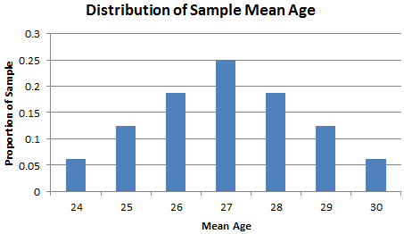
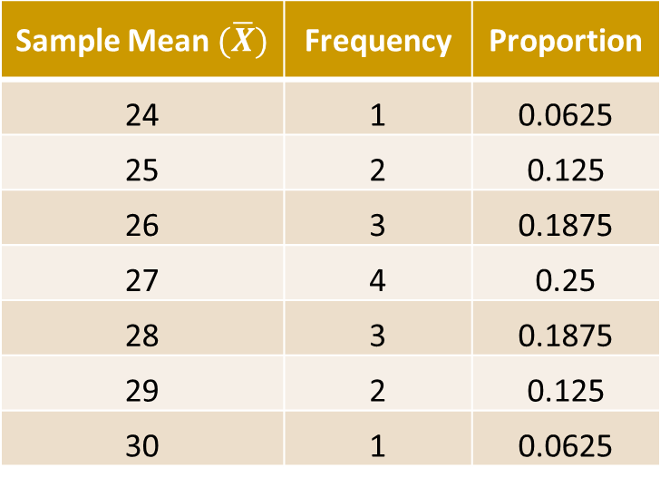
Sampling Distribution of the Sample Mean
Cont’d
Sample mean age is a random variable
The sampling distribution of the mean is:
Sample Mean $(\overline{X})$ | Frequency | Proportion
24 | 1 | 0.0625
25 | 2 | 0.125
26 | 3 | 0.1875
27 | 4 | 0.25
28 | 3 | 0.1875
29 | 2 | 0.125
30 | 1 | 0.0625

Slide 13
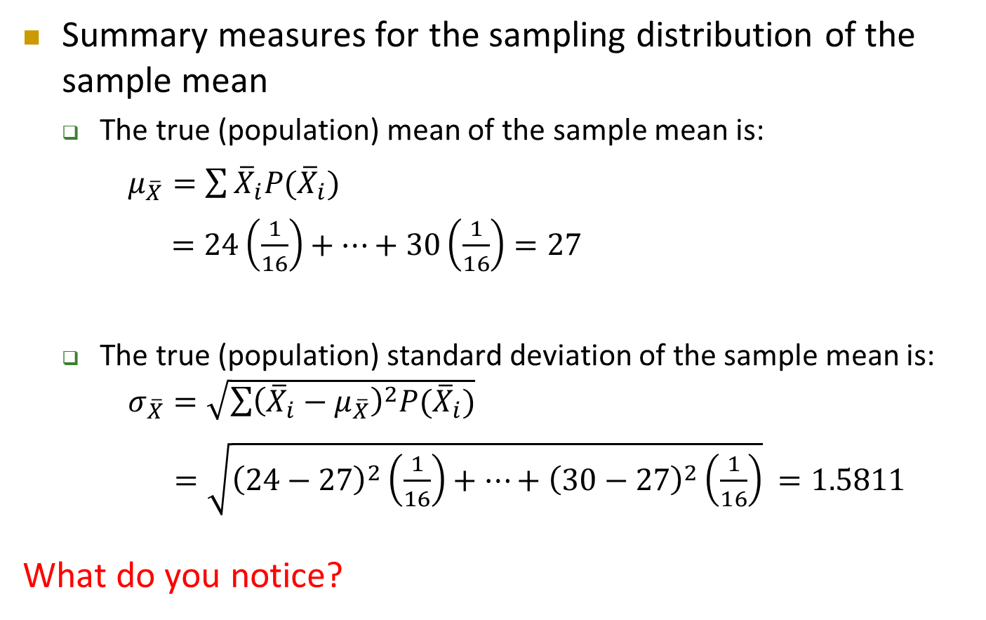
Sampling Distribution of the Sample Mean
Cont’d
Summary measures for the sampling distribution of the sample mean
The true (population) mean of the sample mean is:
$μ_{\overline{X}}=\sum{{\overline{X}}_{i}P({\overline{X}}_{i})}$
$=24\left(\frac{1}{16}\right)+…+30\left(\frac{1}{16}\right)=27$
The true (population) standard deviation of the sample mean is: $σ_{\overline{X}}=\sqrt{\sum{{\left({\overline{X}}_{i}−μ_{\overline{X}}\right)}^{2}P({\overline{X}}_{i})}}$
$=\sqrt{{\left(24−27\right)}^{2}\left(\frac{1}{16}\right)+…+{\left(30−27\right)}^{2}\left(\frac{1}{16}\right)}$ $=1.5811$
What do you notice?

Slide 14
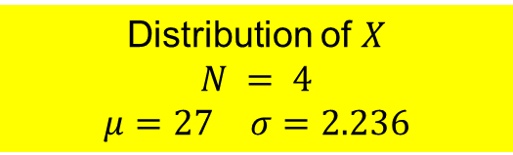

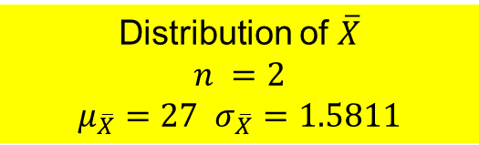
Population Distribution vs. Sampling Distribution of the Sample Mean
Comparing the distribution between $X$ and $\overline{X}$, we observe
Distribution of $X$
$$N = 4$$
$μ=27$ $σ=2.236$
Distribution of $\overline{X}$
$$n =2$$
$μ_{\overline{X}}=27$ $σ_{\overline{X}}=1.5811$

Slide 15
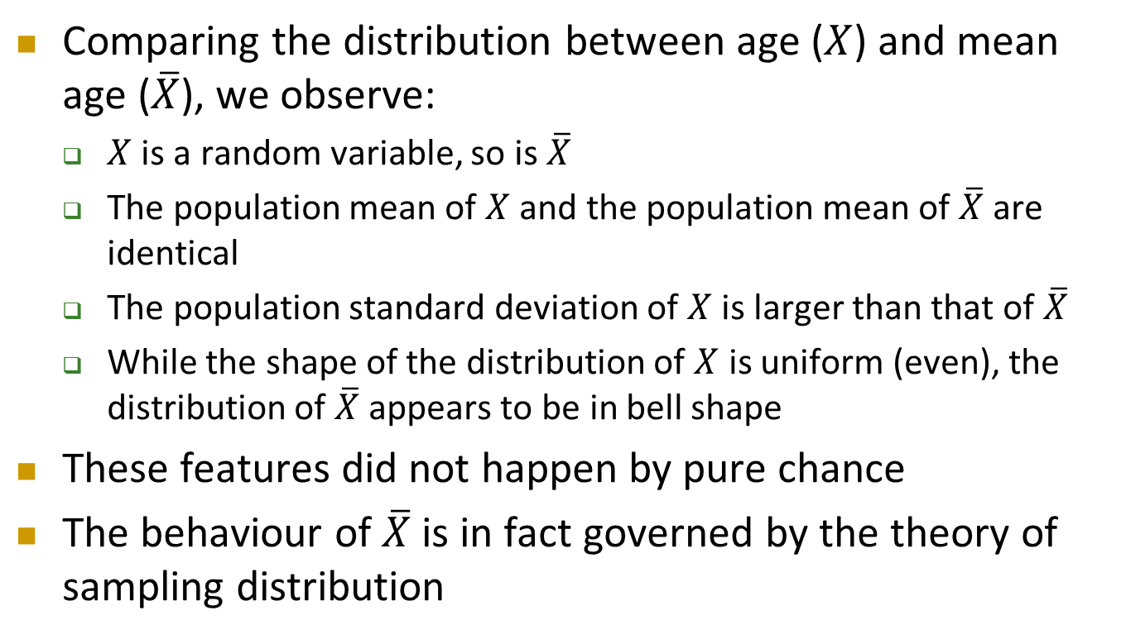
Sampling Distribution of the Sample Mean
Cont’d
Comparing the distribution between age ($X$) and mean age ($\overline{X}$), we observe:
$X$ is a random variable, so is$\overline{X}$
The population mean of $X$ and the population mean of $\overline{X}$ are identical
The population standard deviation of $X$ is larger than that of $\overline{X}$
While the shape of the distribution of $X$ is uniform (even), the distribution of $\overline{X}$ appears to be in bell shape
These features did not happen by pure chance
The behaviour of $\overline{X}$ is in fact governed by the theory of sampling distribution

Slide 16
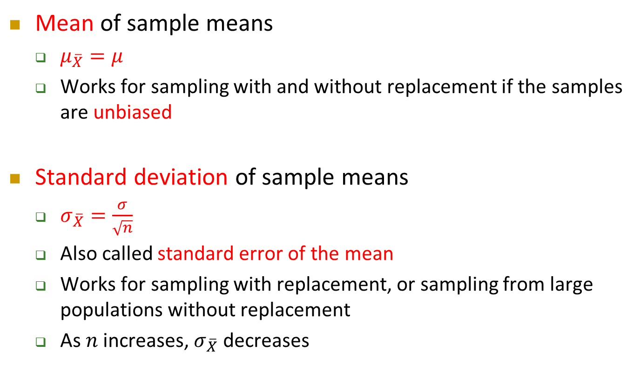
Properties of Sampling Distribution of the Sample Mean
Mean of sample means
$μ_{\overline{X}}=μ$
Works for sampling with and without replacement if the samples are unbiased
Standard deviation of sample means
$σ_{\overline{X}}=\frac{σ}{\sqrt{n}}$
Also called standard error of the mean
Works for sampling with replacement, or sampling from large populations without replacement
As $n$ increases, $σ_{\overline{X}}$ decreases

Slide 17

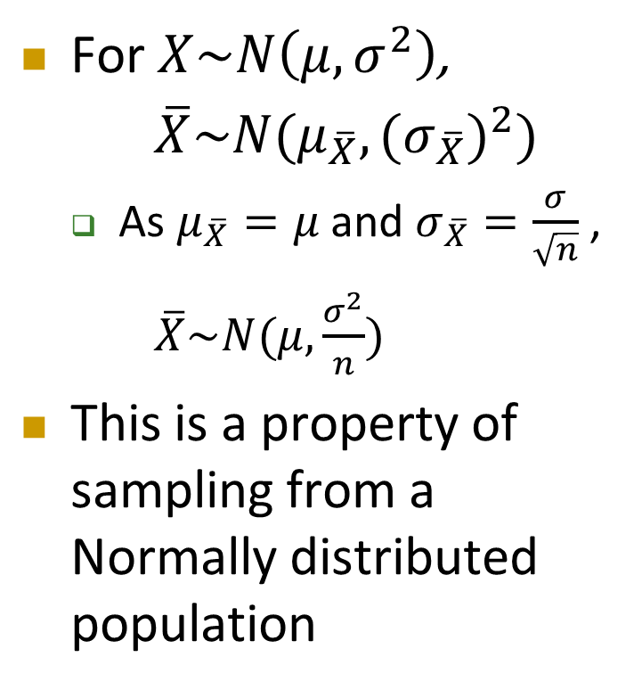
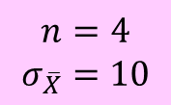


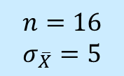


Sampling from Normal Populations
For $X\sim N\left(μ,σ^{2}\right)$,
$\overline{X}\sim N(μ_{\overline{X}},{{(σ}_{\overline{X}})}^{2})$
As $μ_{\overline{X}}=μ \text{and} σ_{\overline{X}}=\frac{σ}{\sqrt{n}}$ ,
$\overline{X}\sim N(μ,\frac{σ^{2}}{n})$
This is a property of sampling from a Normally distributed population
Population Distribution
$$σ=20$$
$$μ=140$$
$$X$$
Sample Mean Distributions
$$n=16$$
$$σ_{\overline{X}}=5$$
$$n=4$$
$$σ_{\overline{X}}=10$$
$$μ_{\overline{X}}=140$$
$$\overline{X}$$

Slide 18
Sampling from Normal Populations – Example
Cont’d
Suppose the packing equipment in a manufacturing process that is filling 350-gram boxes of cereal is set so that the amount of cereal in a box is normally distributed with a mean of 350 grams. From past experience, the population standard deviation for this filling process is known to be 15 grams. If a sample of 25 boxes is randomly selected from the many thousands that are filled in a day, what is the probability that the sample mean is in between 345 grams and 355 grams?

Slide 19
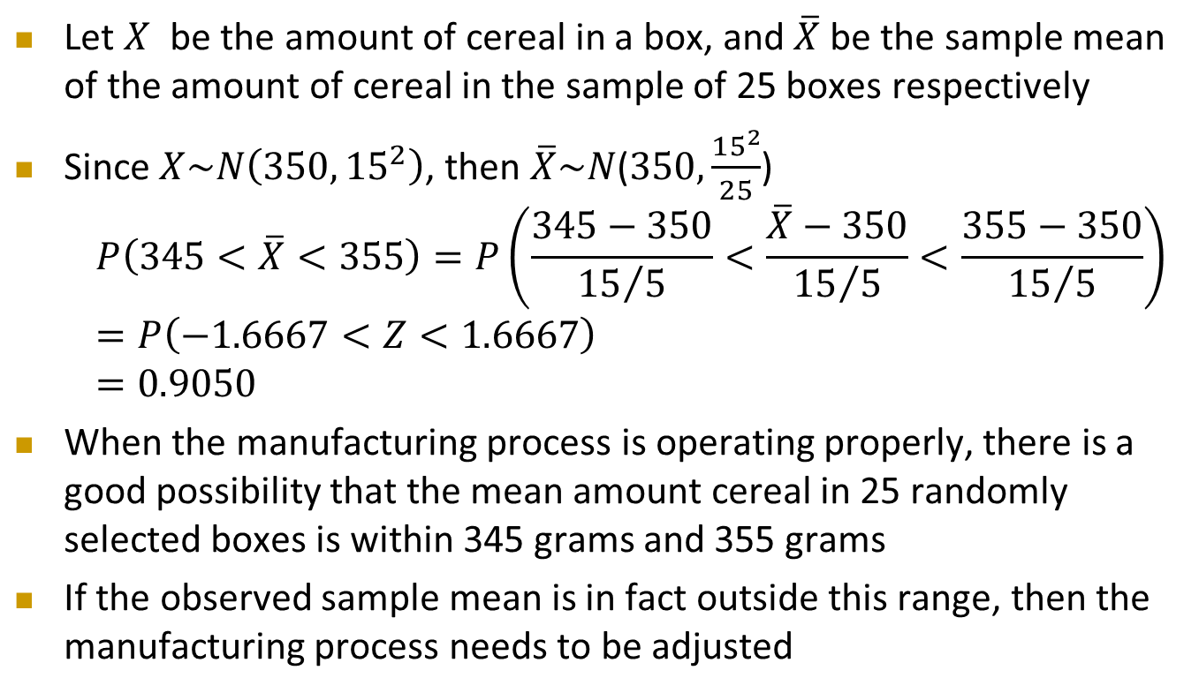
Sampling from Normal Populations – Example
Cont’d
Let $X$ be the amount of cereal in a box, and $\overline{X}$ be the sample mean of the amount of cereal in the sample of 25 boxes respectively
Since $X\sim N\left(350,{15}^{2}\right)$, then $\overline{X}\sim N$($350,\frac{{15}^{2}}{25}$)
$$P\left(345<\overline{X}<355\right)=P\left(\frac{345−350}{{15}/5}<\frac{\overline{X}−350}{{15}/5}<\frac{355−350}{{15}/5}\right)$$
$$=P\left(−1.6667<Z<1.6667\right)$$
$$=0.9050$$
When the manufacturing process is operating properly, there is a good possibility that the mean amount cereal in 25 randomly selected boxes is within 345 grams and 355 grams
If the observed sample mean is in fact outside this range, then the manufacturing process needs to be adjusted

Slide 20
Sampling from Non-Normal Populations
In many instances either we will know the population is not normally distributed or we may believe that it is unrealistic to assume a normal distribution
For example, the monthly salary of people in Hong Kong
What is the sampling distribution of the mean for populations that are not normally distributed?

Slide 21
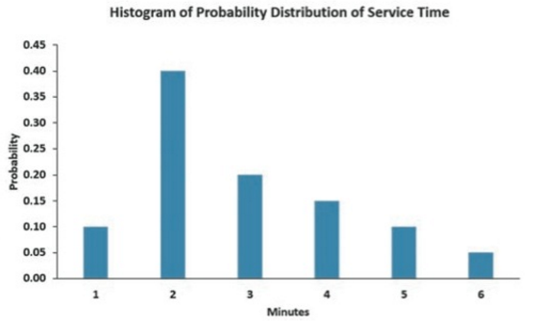
Sampling from Non-Normal Populations – Example
Cont’d
Consider the distribution of time it takes to fill orders at a fast-food chain counter. The population mean service time is 2.9 minutes and the population standard deviation is 1.34 minutes
Service Time (minutes) | Probability
1 | 0.10
2 | 0.40
3 | 0.20
4 | 0.15
5 | 0.10
6 | 0.05

Slide 22
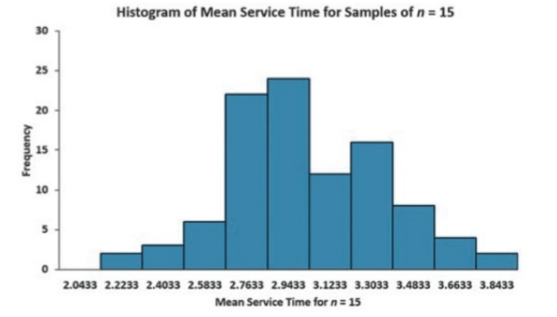
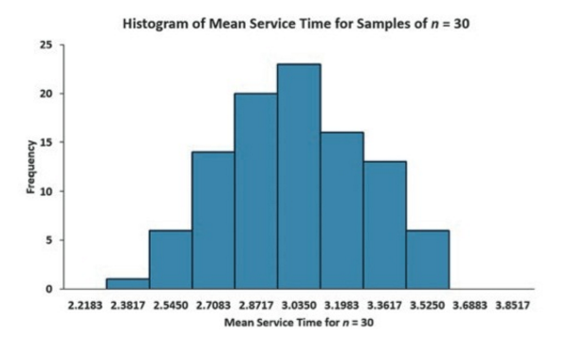
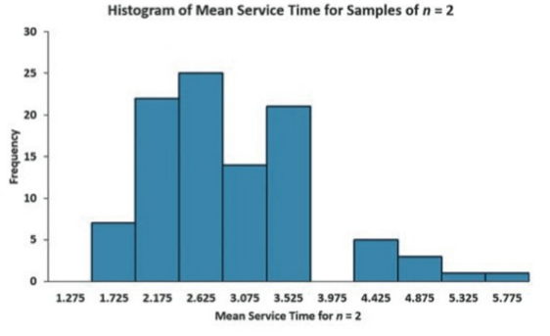
Sampling from Non-Normal Populations – Example
Cont’d
Suppose 100 samples of n = 2, n = 15, n = 30 are selected. For each sample, the sample mean is calculated
Mean Service Time for n = 2
Mean Service Time for n = 15
Mean Service Time for n = 30
Skewed, but not as skewed as the population distribution
Somewhat symmetrical distribution that contains a concentration of values in the center of the distribution
Approximately bell-shaped with a concentration of values in the center of the distribution

Slide 23
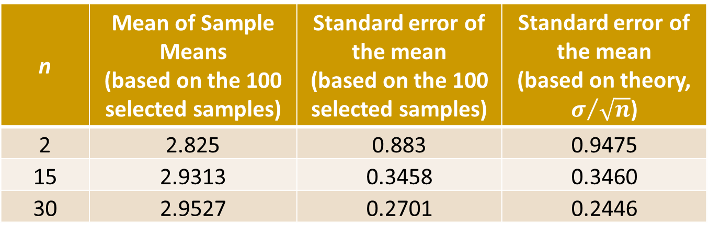
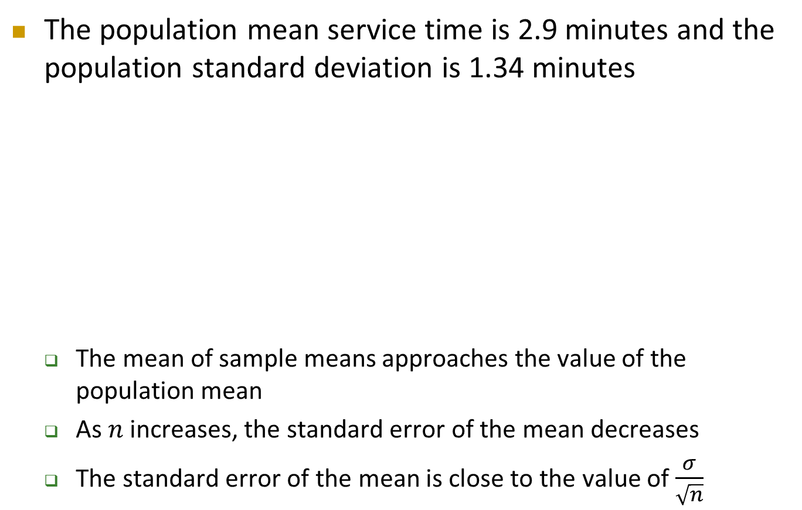
Sampling from Non-Normal Populations – Example
Cont’d
The population mean service time is 2.9 minutes and the population standard deviation is 1.34 minutes
The mean of sample means approaches the value of the population mean
As $n$ increases, the standard error of the mean decreases
The standard error of the mean is close to the value of $\frac{σ}{\sqrt{n}}$
n | Mean of Sample Means (based on the 100 selected samples) | Standard error of the mean (based on the 100 selected samples) | Standard error of the mean (based on theory, $σ/{\sqrt{n}}$)
2 | 2.825 | 0.883 | 0.9475
15 | 2.9313 | 0.3458 | 0.3460
30 | 2.9527 | 0.2701 | 0.2446

Slide 24

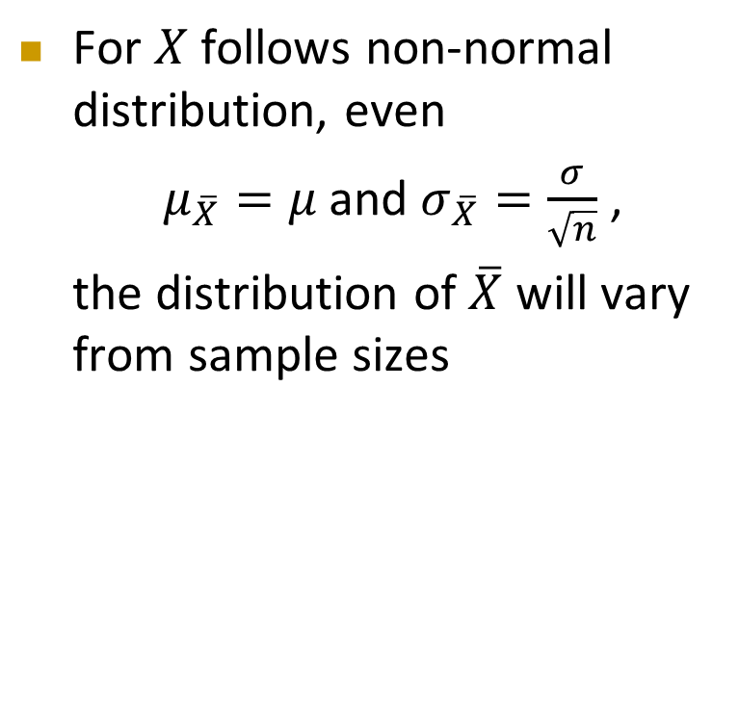




Sampling from Non-Normal Populations
Cont’d
For $X$ follows non-normal distribution, even
$μ_{\overline{X}}=μ \text{and} σ_{\overline{X}}=\frac{σ}{\sqrt{n}}$ ,
the distribution of $\overline{X}$ will vary from sample sizes
Population Distribution
$$σ=1.34$$
$$μ=2.9$$
$$X$$
Sample Mean Distributions
$$n=30$$
$$σ_{\overline{X}}=0.2446$$
$$n=2$$
$$σ_{\overline{X}}=0.9475$$
$$μ_{\overline{X}}=2.9$$
$$\overline{X}$$

Slide 25

Central Limit Theorem
As sample size gets large enough
Sample mean distribution becomes Normal regardless of population distribution
$$\overline{X}$$

Slide 26
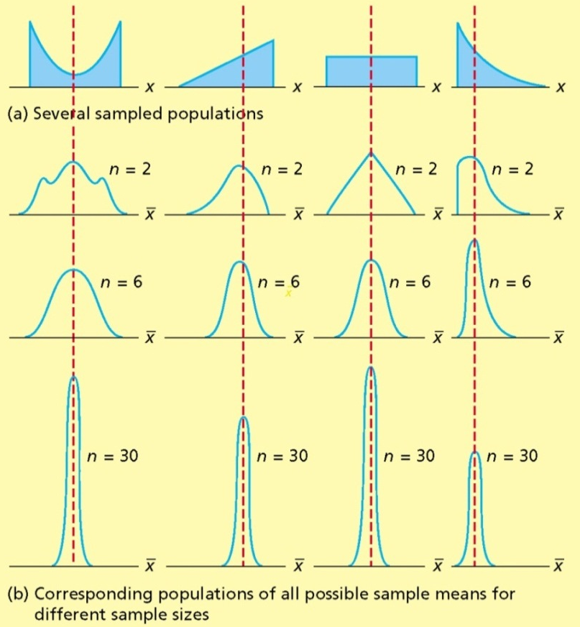

Central Limit Theorem
Cont’d
But how large is large enough?
For most distributions, $n≥30$ is considered as a large sample
The larger the sample size, the more nearly normally distributed is the sampling distributions of the means

Slide 27
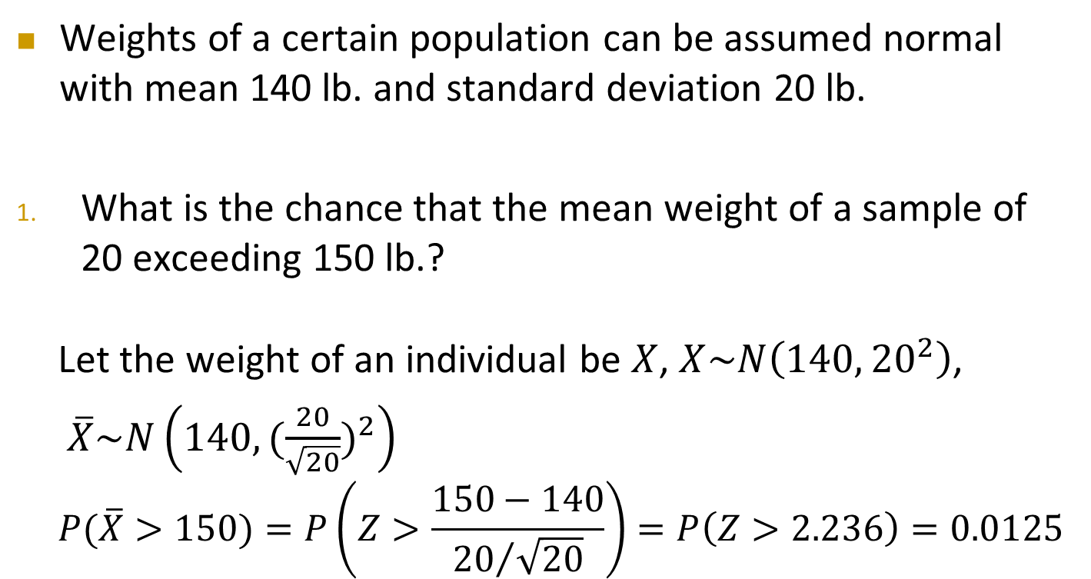
Sampling Distribution – Example
Weights of a certain population can be assumed normal with mean 140 lb. and standard deviation 20 lb.
What is the chance that the mean weight of a sample of 20 exceeding 150 lb.?
Let the weight of an individual be $X$, $X\sim N\left(140,{20}^{2}\right)$,
$\overline{X}\sim N\left(140, {(\frac{20}{\sqrt{20}})}^{2}\right)$
$$P(\overline{X}>150)=P\left(Z>\frac{150−140}{{20}/{\sqrt{20}}}\right)=P\left(Z>2.236\right)=0.0125$$

Slide 28
Sampling Distribution – Exercise
Cont’d
Will the chance be the same if the sample consists of 30 individuals? Why? If your answer is “NO”, what the chance should be?

Slide 29
Sampling Distribution – Exercise
Cont’d
If the 20 individuals are randomly selected from a non-Normal population, what is the probability that its mean weight exceeds 150lb.?

Slide 30
Sampling Distribution – Exercise
Cont’d
For a sample consists of 30 individuals from a non-normal population, what is the probability that its sample mean weight falls between 135 lb. and 150 lb.?

